Slide 1
Intro to Digital Twin with Unity
Connecting Unity to Web API

Slide 2
Session Agenda
Digital Twin
Digital Twin architecture
Communication Protocols for Digital Twin
Unity HTTP Webrequest
Demo: https://github.com/MangoMetaverse/RealWorldWeatherDemo.git
Notes:
https://www.autodesk.com/design-make/articles/what-is-a-digital-twin
https://www.verdantix.com/report/smart-innovators-digital-twins-for-industrial-facilities
https://core.ac.uk/download/pdf/199295333.pdf (digital twin com protocols)
https://www.altexsoft.com/blog/digital-twins/
https://medium.com/@sonusprocks/unity-webrequest-made-simple-92d967a1b86c

Slide 3
Digital Twin
A digital twin is a virtual model designed to accurately reflect a physical object, process, or system.
Vendors offer digital twin software at five different levels of sophistication – from digital twins that integrate data from various sources to one capable of acting autonomously
Level 1: Descriptive twin
Level 2: Informative twin
Level 3: Predictive twin
Level 4: Comprehensive twin
Level 5: Autonomous twin
Notes:
Level 1: Descriptive twin
The descriptive twin is a live, editable version of design and construction data—a visual replica of a built asset. Users specify what kind of information they want included and what kind of data they want to extract.
Level 2: Informative twin
This level has an added layer of operational and sensory data. The twin captures and aggregates defined data and verifies data to make sure that systems work together.
Level 3: Predictive twin
This twin can use operational data to gain insights. (Think of a car letting you know when it’s time for an oil change.)
Level 4: Comprehensive twin
This twin simulates future scenarios and considers “what-if” questions.
Level 5: Autonomous twin
This twin has the ability to learn and act on behalf of users.
It’s important to note that levels 1 and 2 are currently in use in AEC. Levels 3, 4, and 5, which are enriched with real-time data from embedded sensors and IoT technologies, are on the horizon.

Slide 4
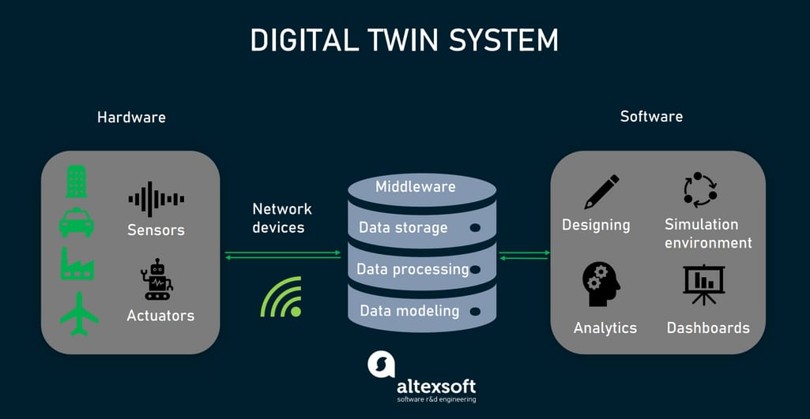
The Architecture
A digital twin system contains :
Hardware components.
Data management middleware.
Software components.
Notes:
Hardware : the Internet of Things (IoT) sensors, that initiate the exchange of information between assets and their software representation.
Data management middleware : Element that centralized all data from different sources, this component will connect, integrate, process, test/clean, visualize, modelling, & more.
Software : software component turns raw observations into valuable business insights.

Slide 5
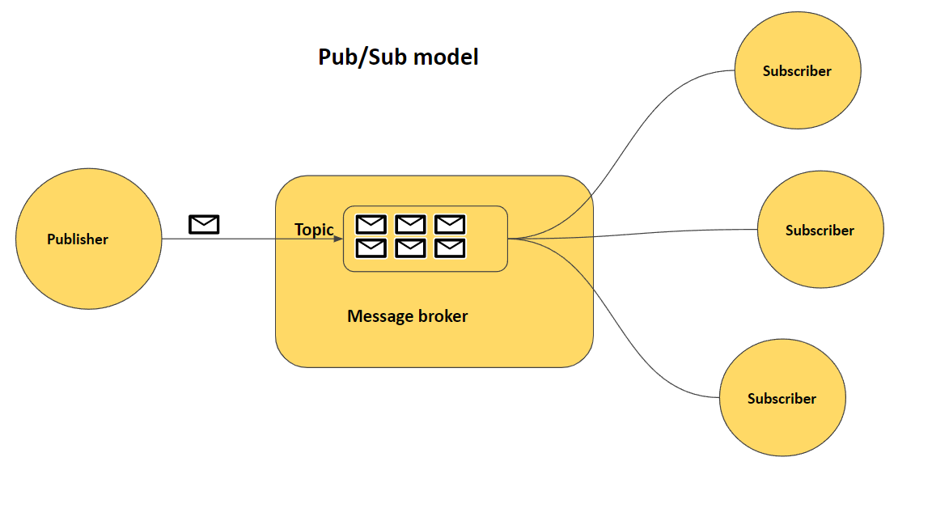
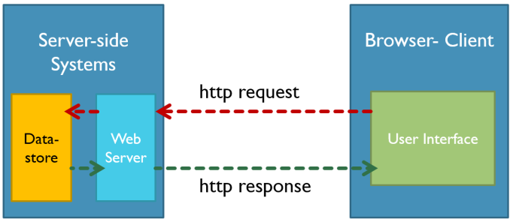
Application Layer Communication protocol
Application layer communication protocols for DT can classified to 2 categories by its communication model
Request/response
Publish/subscribe (pub-sub)
Notes:
Hardware : the Internet of Things (IoT) sensors, that initiate the exchange of information between assets and their software representation.
Data management middleware : Element that centralized all data from different sources, this component will connect, integrate, process, test/clean, visualize, modelling, & more.
Software : software component turns raw observations into valuable business insights.

Slide 6
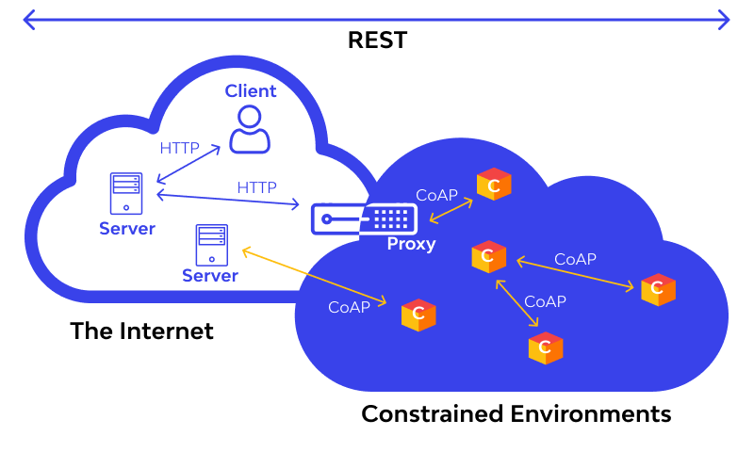
Protocol With Request/Response model
A digital twin system can use these protocol for communication
HTTP (Hypertext Transfer Protocol) is a widely used application layer protocol and a basic building block of the World Wide Web
CoAP (Constrained Application Protocol), is a request/response protocol.

Slide 7
Protocol With Publisher/Subscriber model
MQTT (Message Queuing Telemetry Transport) is a lightweight publisher/subscriber
XMPP (Extensible Messaging and Presence Protocol) is commonly used communication and messaging protocol in IoT
AMQP (Advanced Message Queuing Protocol) follows a publish/subscribe model & Request/Response
DDS (Data Distribution Service) follows a publish-subscribe model
OPC UA (Open Platform Communications Unified Architecture) supports both Client/Server and Publish/Subscribe models.

Slide 8
Unity HTTP Webrequest
UnityWebRequest is a powerful Unity API that allows developers to interact with web services and APIs.
Whether you need to download data, send HTTP requests, or upload content, UnityWebRequest provides a flexible and feature-rich solution.
UnityWebRequest is Unity’s built-in system for handling HTTP requests. It supports various HTTP methods such as GET, POST, PUT, DELETE
Notes:
https://medium.com/@sonusprocks/unity-webrequest-made-simple-92d967a1b86c

Slide 9
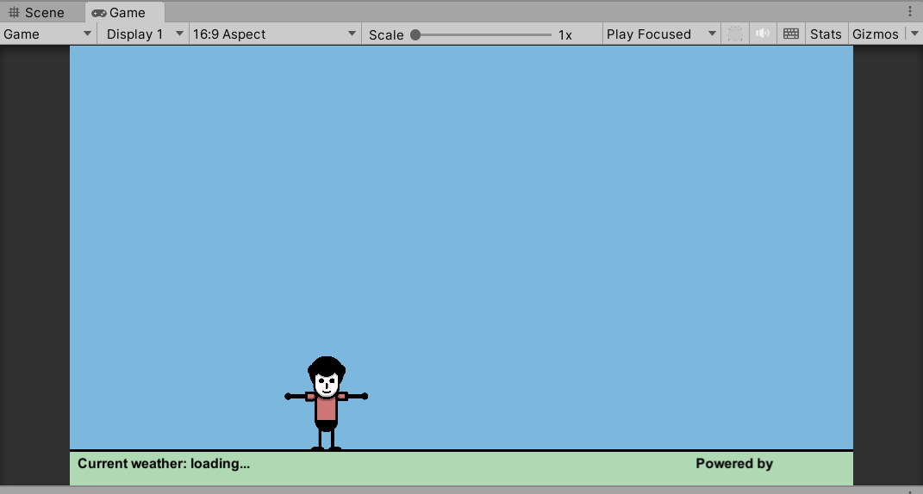
Demo Unity HTTP Webrequest
Download Sample project from
https://github.com/MangoMetaverse/RealWorldWeatherDemo.git
Notes:
https://medium.com/@sonusprocks/unity-webrequest-made-simple-92d967a1b86c

Slide 10
Demo Unity Script Structure
Script Structure :
Cloud.cs : to animate cloud object
Player.cs : to control Player character. (follow mouse cursors)
GetLocation.cs : to get Current location based on IP
WeatherData.cs : to get weather data based on current location. (city)
StateManager.cs : to manage the state of application environment based on the weather. (using weather code.)
Notes:
https://medium.com/@sonusprocks/unity-webrequest-made-simple-92d967a1b86c

Slide 11
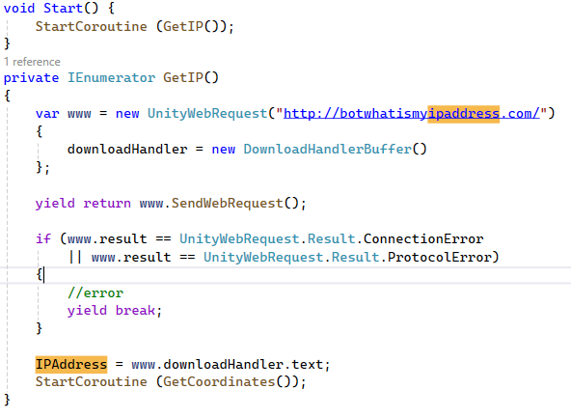
How to get Location (1)
Get the current IP public using http://botwhatismyipaddress.com/ inside GetLocation.cs
Notes:
https://medium.com/@sonusprocks/unity-webrequest-made-simple-92d967a1b86c

Slide 12
How to get Location (1)
Get the current IP public using http://botwhatismyipaddress.com/ inside GetLocation.cs
void Start() {
StartCoroutine (GetIP());
}
private IEnumerator GetIP() {
var www = new UnityWebRequest("http://botwhatismyipaddress.com/") {
downloadHandler = new DownloadHandlerBuffer()
};
yield return www.SendWebRequest();
if (www.result == UnityWebRequest.Result.ConnectionError
|| www.result == UnityWebRequest.Result.ProtocolError){
//error
yield break;
}
IPAddress = www.downloadHandler.text;
StartCoroutine (GetCoordinates());
}
Notes:
https://medium.com/@sonusprocks/unity-webrequest-made-simple-92d967a1b86c

Slide 13
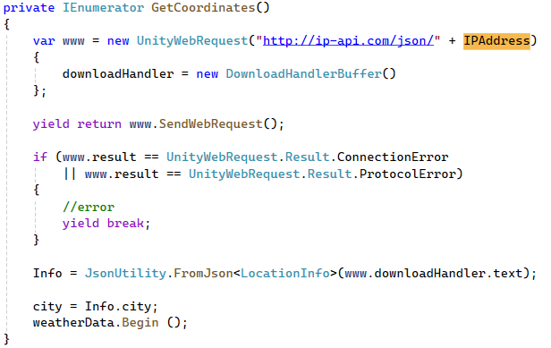
How to get Location (2)
Get the city from current public IP using http://ip-api.com/json/ inside GetLocation.cs
Notes:
https://medium.com/@sonusprocks/unity-webrequest-made-simple-92d967a1b86c

Slide 14
How to get Location (2)
Get the city from current public IP using http://ip-api.com/json/ inside GetLocation.cs
private IEnumerator GetCoordinates() {
var www = new UnityWebRequest("http://ip-api.com/json/" + IPAddress)
{
downloadHandler = new DownloadHandlerBuffer()
};
yield return www.SendWebRequest();
if (www.result == UnityWebRequest.Result.ConnectionError
|| www.result == UnityWebRequest.Result.ProtocolError) {
yield break;
}
Info = JsonUtility.FromJson<LocationInfo>(www.downloadHandler.text);
city = Info.city;
weatherData.Begin ();
}
Notes:
https://medium.com/@sonusprocks/unity-webrequest-made-simple-92d967a1b86c

Slide 15
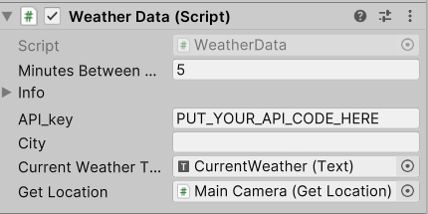
How to get WeatherData
Get the current location weather from https://www.weatherapi.com
Usually, you need to signup and then find your API key under your account and start using API right away!
For simplicity, we will use this API key together
eb75ab4eb5bf482fb9b154507240609
Put it at API_key variable on the Main Camera Object
Notes:
https://medium.com/@sonusprocks/unity-webrequest-made-simple-92d967a1b86c

Slide 16
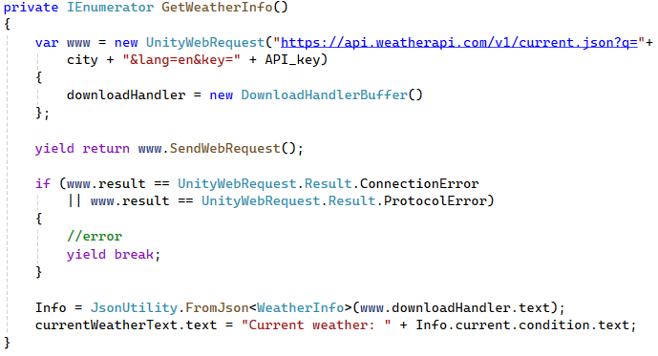
How to get WeatherData
Get the current location weather from https://api.weatherapi.com inside WeatherData.cs
Notes:
https://medium.com/@sonusprocks/unity-webrequest-made-simple-92d967a1b86c

Slide 17
How to get WeatherData
Get the current location weather from https://api.weatherapi.com inside WeatherData.cs
private IEnumerator GetWeatherInfo() {
var www = new UnityWebRequest("https://api.weatherapi.com/v1/current.json?q="+
city + "&lang=en&key=" + API_key)
downloadHandler = new DownloadHandlerBuffer()
};
yield return www.SendWebRequest();
if (www.result == UnityWebRequest.Result.ConnectionError
|| www.result == UnityWebRequest.Result.ProtocolError) {
//error
yield break;
}
Info = JsonUtility.FromJson<WeatherInfo>(www.downloadHandler.text);
currentWeatherText.text = "Current weather: " + Info.current.condition.text;
}
Notes:
https://medium.com/@sonusprocks/unity-webrequest-made-simple-92d967a1b86c

Slide 18
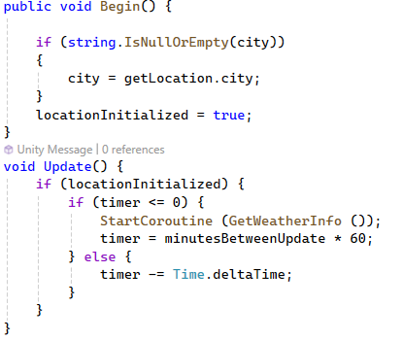
Makes weather auto update
Make sure the weather status always updated in WeatherData.cs
Notes:
https://medium.com/@sonusprocks/unity-webrequest-made-simple-92d967a1b86c

Slide 19
Make weather auto update
Make sure the weather status always updated in WeatherData.cs
public void Begin() {
if (string.IsNullOrEmpty(city)) {
city = getLocation.city;
}
locationInitialized = true;
}
void Update() {
if (locationInitialized) {
if (timer <= 0) {
StartCoroutine (GetWeatherInfo ());
timer = minutesBetweenUpdate * 60;
} else {
timer -= Time.deltaTime;
}
}
}
Notes:
https://medium.com/@sonusprocks/unity-webrequest-made-simple-92d967a1b86c

Slide 20
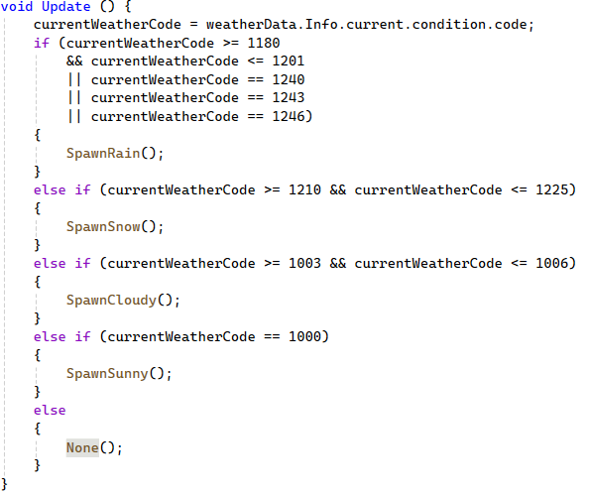
Simulate based on current weather data
We can simulate the weather using code from weather data.
Here is the reference code https://www.weatherapi.com/docs/weather_conditions.json
We will put the co inside StateManager.cs
Notes:
https://medium.com/@sonusprocks/unity-webrequest-made-simple-92d967a1b86c

Slide 21
Simulate based on current weather data
We can simulate the weather using code from weather data.
Here is the reference code https://www.weatherapi.com/docs/weather_conditions.json
We will put the co inside StateManager.cs
void Update () {
currentWeatherCode = weatherData.Info.current.condition.code;
Debug.Log("The currentWeatherCode = "+currentWeatherCode );
if (currentWeatherCode >= 1180) {
SpawnRain();
}
else if (currentWeatherCode >= 1210) {
SpawnSnow();
}
else if (currentWeatherCode >= 1003) {
SpawnCloudy();
}
else if (currentWeatherCode == 1000) {
SpawnSunny();
}
else {
None();
}
}
Notes:
https://medium.com/@sonusprocks/unity-webrequest-made-simple-92d967a1b86c

Slide 22
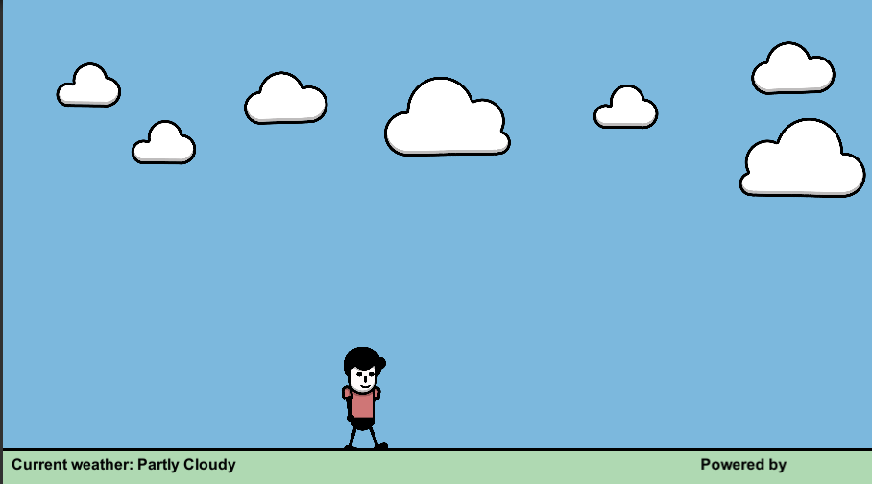
Final Result
Notes:
https://medium.com/@sonusprocks/unity-webrequest-made-simple-92d967a1b86c

Slide 23
Summary
A digital twin is a virtual model designed to accurately reflect a physical object, process, or system.
digital twin software has five different levels of sophistication.
Application layer communication protocols for DT can classified to 2 categories by its communication model
Request/response
Publish/subscribe (pub-sub)
UnityWebRequest is a powerful Unity API that allows developers to interact with web services and APIs through HTTP protocol.
Notes:
https://medium.com/@sonusprocks/unity-webrequest-made-simple-92d967a1b86c

Slide 24
Refrence
https://www.autodesk.com/design-make/articles/what-is-a-digital-twin
https://learn.unity.com/tutorial/introduction-to-digital-twins-with-unity
https://github.com/PolyMarsDev/Real-World-Weather for base assets and code sample

